Slide 1

Front-End Development Overview
CREATED BY: Diana Slepikaite DATE: November - 2024
Notes:
Welcome,
Intro about me: CS background, full stack roles, interest in entrepreneurship and support for female founders
What we gonna do today: A bit on what exactly is frontend and its history, some key technologies, some really smart tools and what does AI bring to the table

Slide 2

What is Front-End?
UNDERSTANDING THE FRONT-END
The front-end is everything users see and interact with on a website or app. It's made up of structure (HTML), style (CSS), and behavior (JavaScript) to enhance user engagement.
Notes:
Ask the question and see if anyone would like to answer it.
Give the restaurant example ( we go to the kitchen in the next session)

Slide 3
Front-End Evolution
2020
AI INTEGRATION
2017-2020
The integration of AI tools into the development workflow has begun
2010-1017
MODERN TOOLS
Frontend development matured with utility-first CSS frameworks, enhanced JavaScript capabilities, and no-code platforms.
FRAMEWORK ERA
The rise of JavaScript frameworks and responsive design patterns.
2000-2010
1991-2000
WEB STANDARDS
EARLY WEB
Standardization of web technologies and the emergence of modern browsers and mobile web development
The foundational technologies of HTML, CSS, and JavaScript were introduced
Notes:
Early Web (1991-1998): The foundational technologies of HTML, CSS, and JavaScript were introduced, establishing the core building blocks of web development that we still use today.
Web Standards (2000-2009): This era focused on standardizing web technologies and saw the emergence of modern browsers and mobile web development, revolutionizing how we access the internet.
Framework Era (2010-2015): The rise of JavaScript frameworks and responsive design patterns transformed frontend development into a more structured and component-based discipline, making complex web applications possible.
Modern Tools (2017-2020): Frontend development matured with utility-first CSS frameworks, enhanced JavaScript capabilities, and no-code platforms, making web development more accessible to non-developers.
AI Integration (2021-2024): The integration of AI tools into the development workflow has begun automating many aspects of frontend development, from code completion to component generation, marking a new era of AI-assisted development.

Slide 4
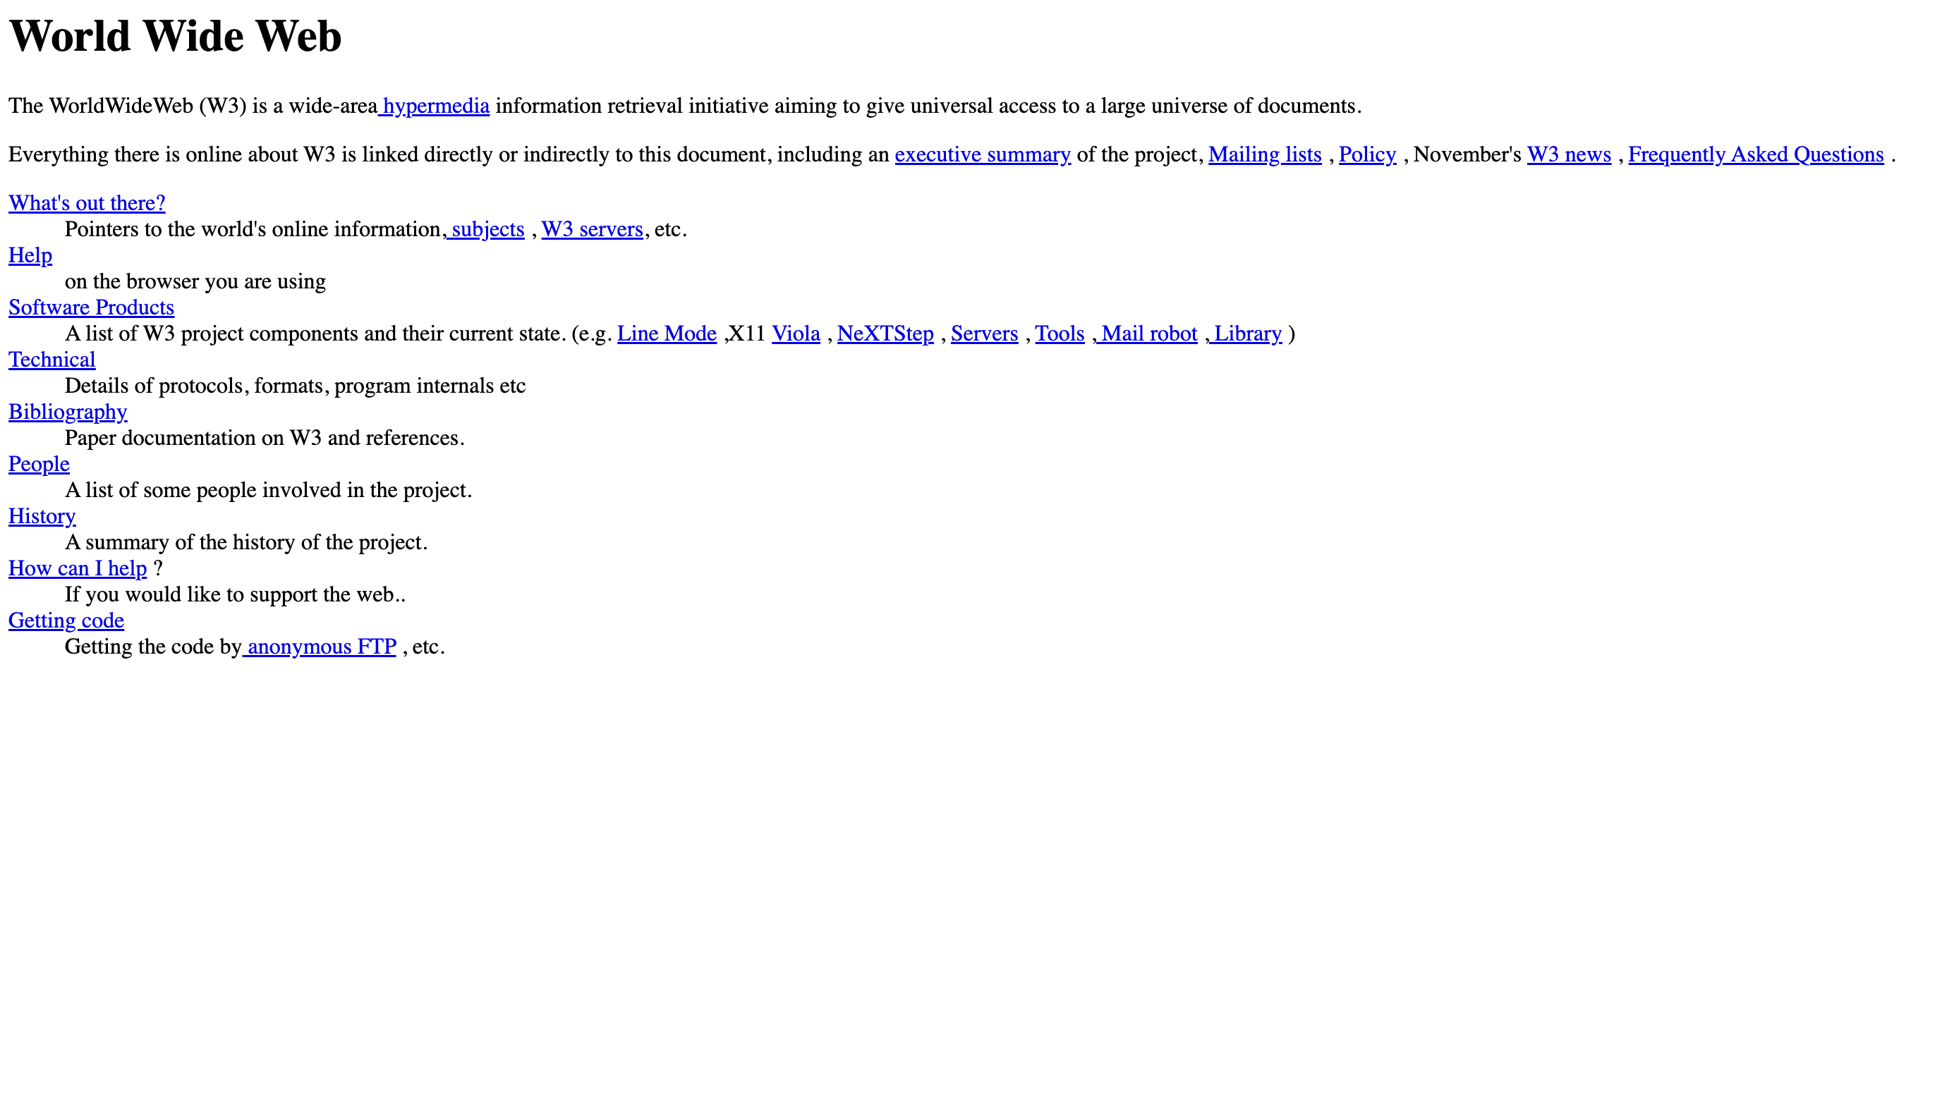
Notes:
Where it started: https://info.cern.ch/hypertext/WWW/TheProject.html

Slide 5

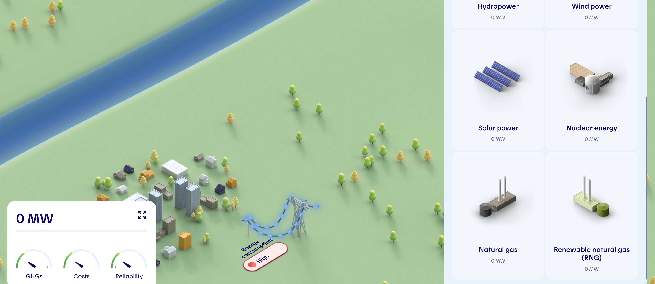
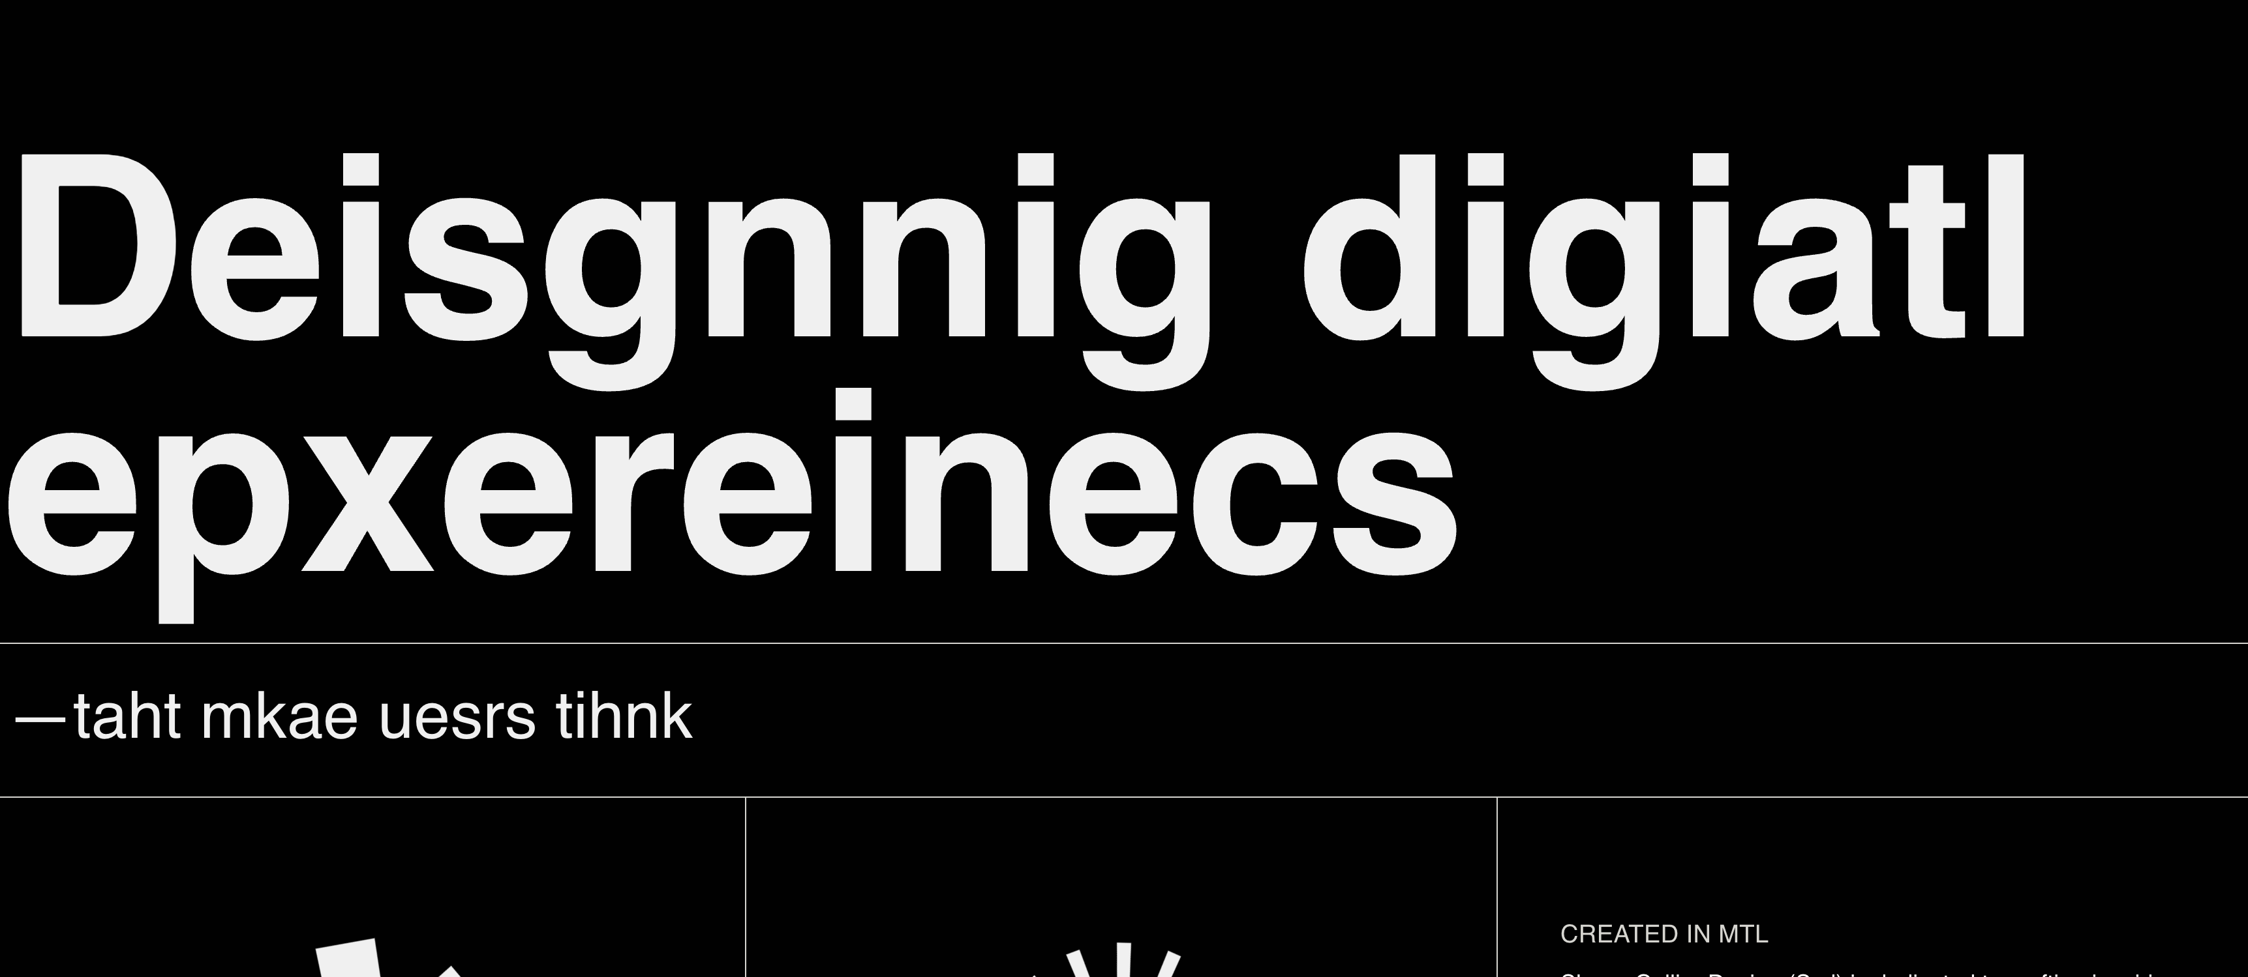
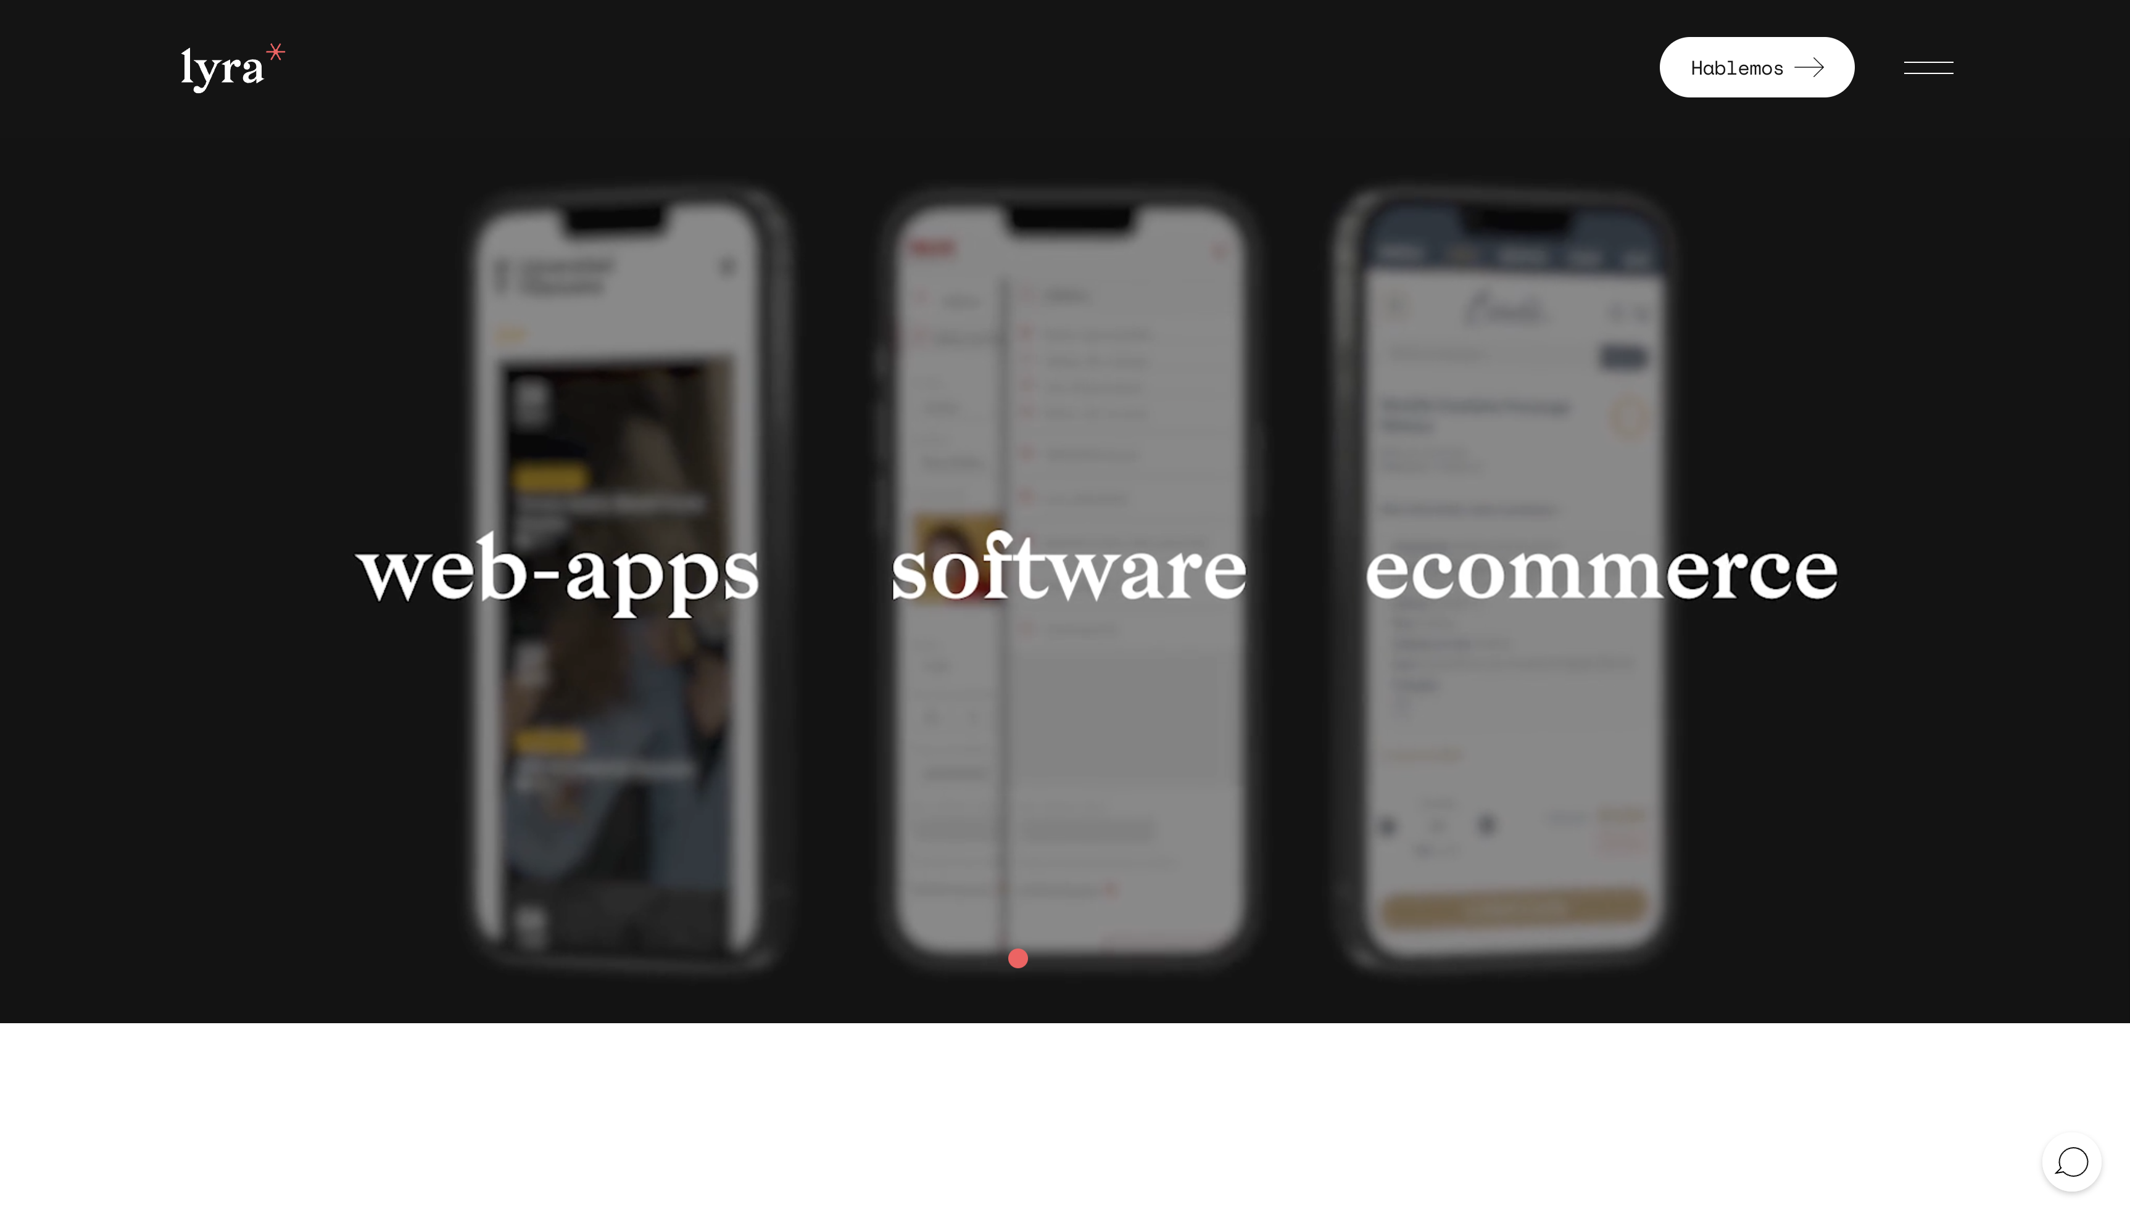
Notes:
Amazing designs we can create now: https://robin-noguier.com/ https://mission2035.hydroquebec.com/en
https://shanecollierdesign.ca/
https://www.lyra.digital/
and more: https://www.awwwards.com/websites/web-interactive/

Slide 6
Key Technologies
These technologies form the backbone of front-end development, each serving a distinct role. Understanding these is vital for any developer.
TECHNOLOGY | PURPOSE | YEAR INTRODUCED
HTML | Structure of web pages | 1991
CSS | Styling and layout | 1994
JavaScript | Client-side interactions | 1995
React | Component-based architecture | 2013
Tailwind CSS | Utility-first styling | 2017
Notes:
HTML (HyperText Markup Language): The skeleton of web pages. Defines the structure and content using elements like headings, paragraphs, images, and links. Think of it as the blueprint of a website.
CSS (Cascading Style Sheets): The styling language that makes websites visually appealing. Controls layout, colors, fonts, spacing, animations, and responsiveness. It's like the interior designer of the web
JavaScript: The programming language that makes websites interactive. Handles user actions, updates content dynamically, manages data, and creates complex functionality. It's the behaviour layer of web applications.
TypeScript: A superset of JavaScript that adds static typing (more strict on the types, cannot assign a string to a variable that was set as number) . Helps catch errors before runtime by requiring you to declare variable types. Makes code more reliable and easier to maintain, especially in large applications.
React: A JavaScript library for building user interfaces using reusable components. Makes it easier to create complex applications by breaking them down into smaller, manageable pieces. Uses a virtual DOM for efficient updates.
DOM stands for Document Object Model. It's a programming interface that represents your webpage as a tree structure of objects. Each HTML element (like paragraphs, divs, spans) becomes a node in this tree, and programming languages like JavaScript can manipulate these nodes to change the webpage's content, structure, and style.
Think of the Virtual DOM like a "blueprint" that React uses to optimize webpage updates. Regular DOM: Making changes one at a time (paint wall, then change floor, then change lights) Virtual DOM: Making all plans first (blueprint), then doing all changes at once efficiently. The Virtual DOM is particularly valuable in modern web apps where data changes frequently.
Tailwind: CSS A utility-first CSS framework that provides pre-built classes for styling. Instead of writing custom CSS, you apply classes directly in HTML. Speeds up development by eliminating the need to write custom CSS.
Node.js: A JavaScript runtime that allows JavaScript to run outside the browser. Used for backend development, building tools, and running development servers. Essential for modern frontend development workflows.

Slide 7
No-Code Tools
WORDPRESS
WIX
BUBBLE.IO
A popular CMS enabling easy website creation, suitable for blogs and small business sites.
Provides drag-and-drop functionality for building sites without coding knowledge.
A powerful no-code platform for developing complex web applications with visual programming.
Notes:
In this day and age you not necerely need to be a top noch developer to create a cool page. There are almost too many tools to create what you need.
WordPress is one of the oldest and most well known tools for the quick website building.
Wix provides the drag and drop functionality and a chance to create modern interactive webpages that would take your breath away.
Bubble.io is a tool that could bring your more complex apps to life.
But while these tools try to simplify the process of bringing your ideas to life, it does not mean that it will be effortless. Each and every tool has its own suites and its own quirks. And also, it costs. As from a developers perspective, they are cool, but when you know how to code, and you go and try this kinda tool, you start getting frustrated with certain functionalities.
But once again, it is an option, an a good one. As everything, you have to weight your options and needs, and decide the path that would work the best for you.

Slide 8
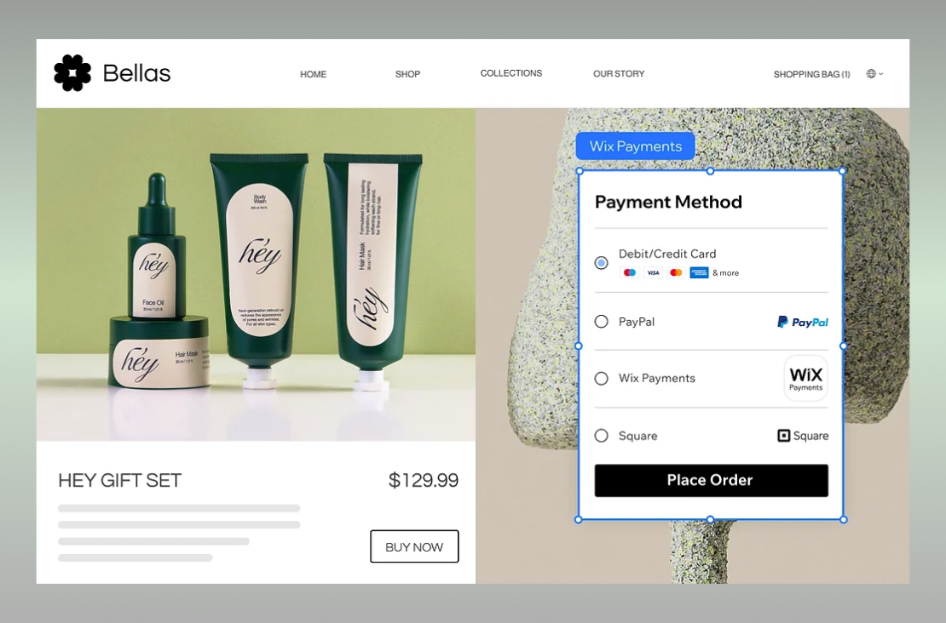
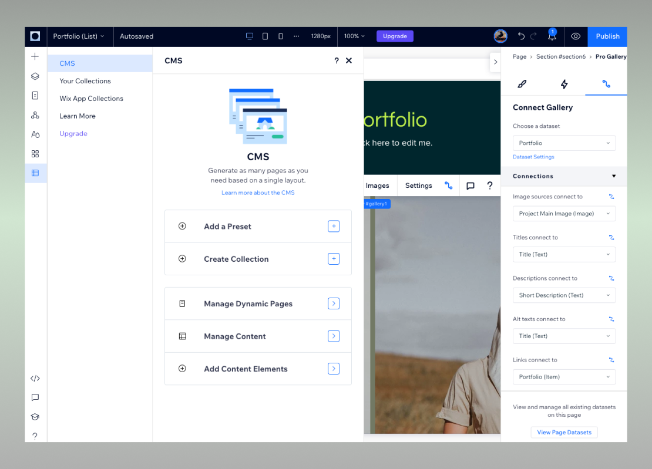
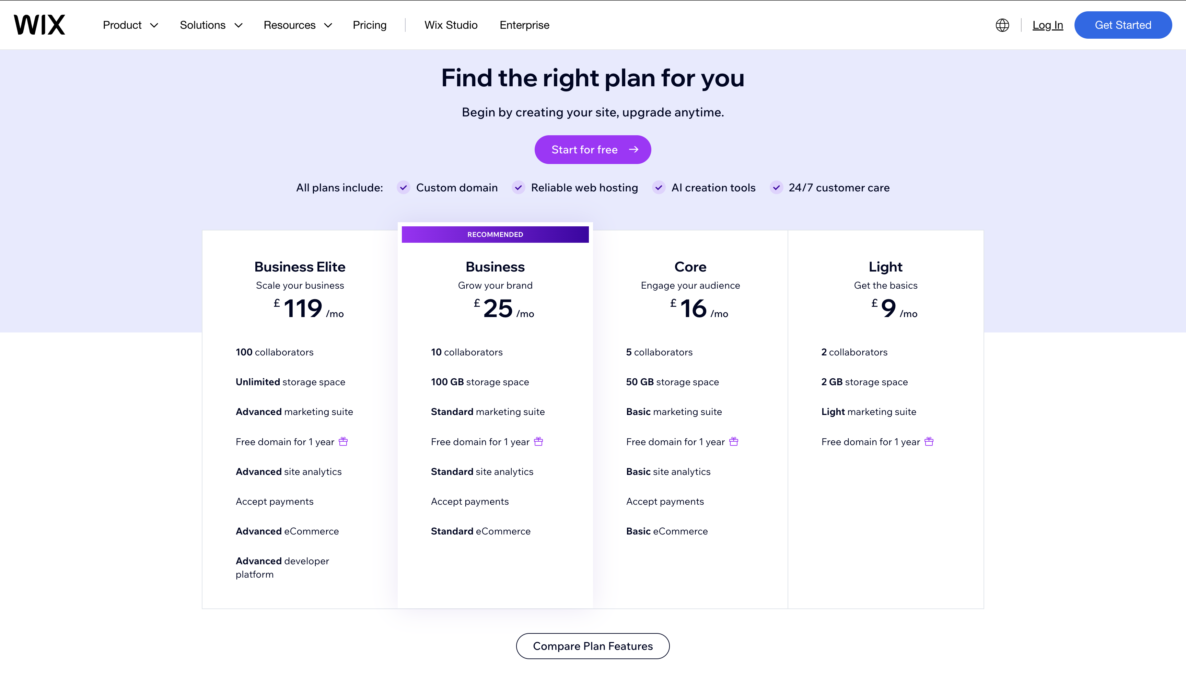
WIX

Slide 9
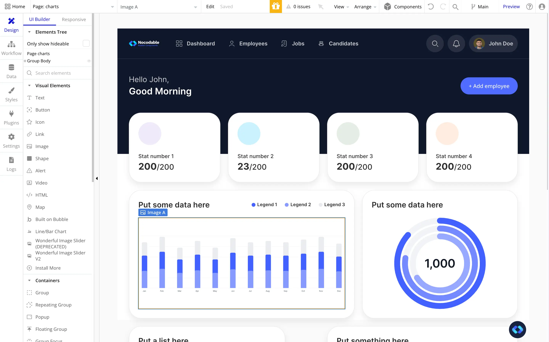
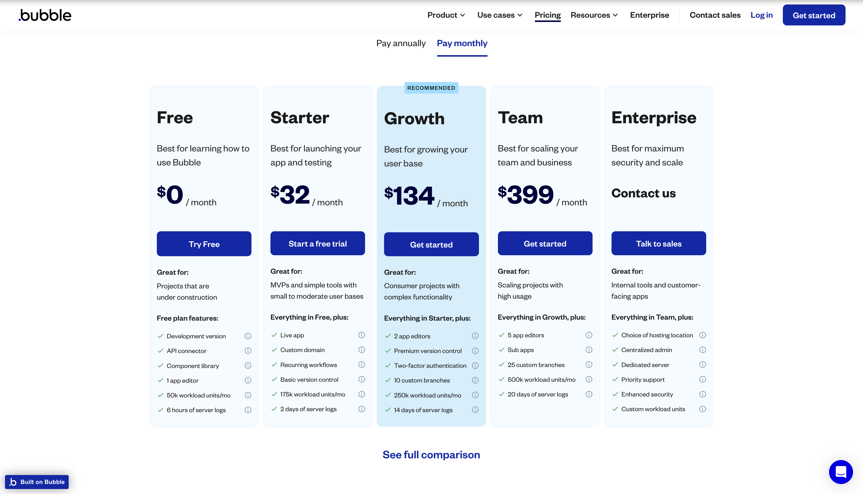
Bubble.io

Slide 10
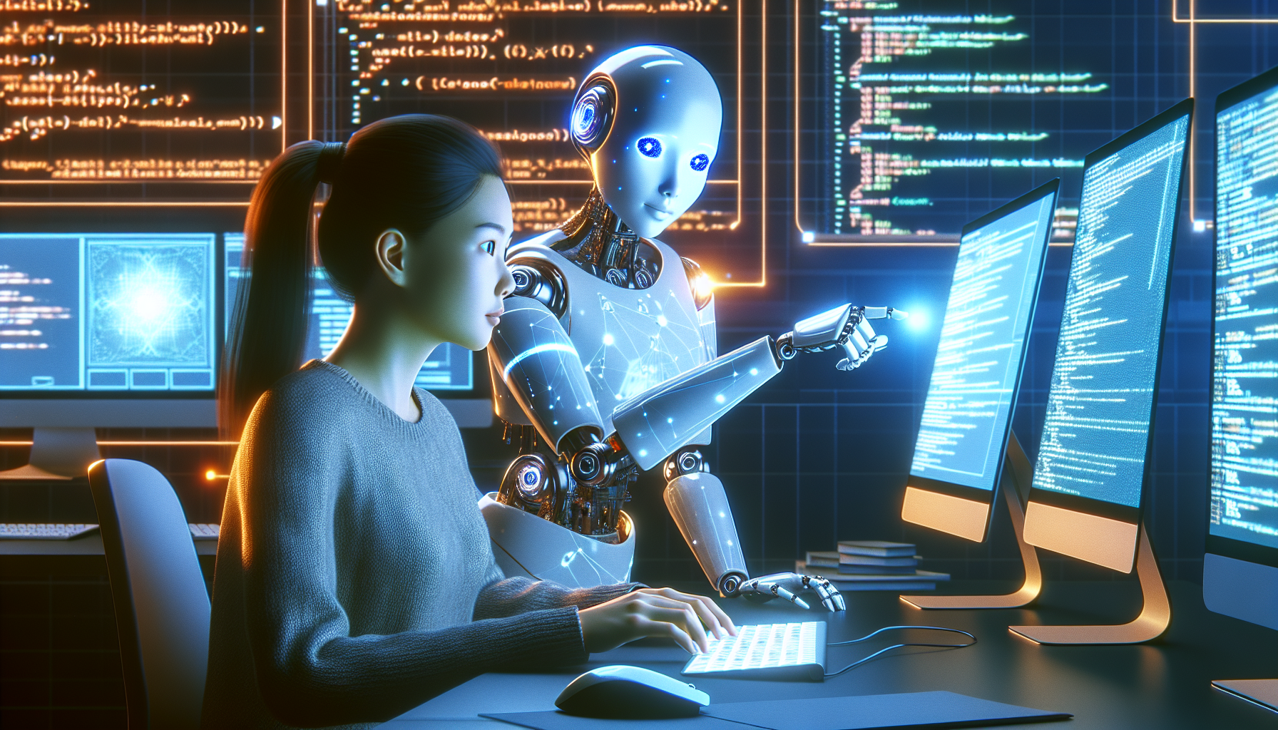
AI Impact on Dev
TRANSFORMING DEVELOPMENT
AI tools like GitHub Copilot facilitate quick code creation, reduce errors, and enhance efficiency. They represent a significant shift in how developers write code.
DESIGN AUTOMATION
AI design platforms allow for rapid creation of visuals and layouts. This streamlines workflows, enabling developers to focus on functionality.
Notes:
AI is revolutionizing how we, developers work. It makes certain processes way easier, finding solutions for certain problems faster, it helps with testing too. It is amazing for learning and understanding too. As well as making your ideas a reality, or at least visualising them (potentially after many iterations). But to code with AI you still need to have minimal understanding of what you doing. AI is a product of humans, and because humans make mistakes, so does the AI. For now, you cannot fully trust everything that AI spits out to you. You need to understand your needs, and functionalities. You need to know the features of your idea and how to explain it to the AI for it to understand you. And you need to know how everything connects together. You need to understand why things fail when they do.
So AI is amazing, and we are going to play around with it today, but when using AI, take it with a pinch of salt, as it is in a stage of learning, the same as you.
Bolt.now
V0.dev
Cloude.ai
Chatgpt
Githubs copilot
Github spark no code (new stuff)

Slide 11
Summary & Future
CONCLUDING THOUGHTS
Front-end development has transformed dramatically. The integration of AI and no-code tools promise to reshape how we build and interact with web applications in the future.
Notes:
Any questions?
We shall now move to some basics and then play around with AI. Bolt.now

